Slide 1
Creating Box and Whisker Plots
Taylor Graham

Slide 2
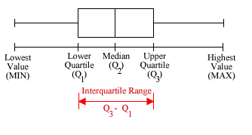
What is a Box and Whisker Plot?
Graphically pictures groups of numerical data through their five-number summaries: the smallest data value, lower quartile (Q1), median (Q2), upper quartile (Q3), and largest data value. A boxplot may also indicate which observations, if any, might be considered outliers.

Slide 3
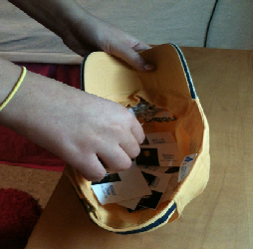
The Beginning Steps…
To find each part of a box and whisker plot, there are particular steps you need to follow.
Each student will have picked a president and use that particular persons age to further base their answers off of.
We begin by first collecting the data from each presidents age and arranging it from least to greatest.
From here we can now begin to find each essential part to create our box and whisker plot as a whole.

Slide 4
Finding the Median (Q2)
Finding the median divides the data into two halves. It is the middle number in the whole set of data. In our case our numerical values are:
57, 57, 58, 57, 61, 68, 64, 48, 52, 49, 42, 56, 55, 51, 60, 62, 43, 55, 56, 69, 64, 46, 54, 47, 49
However we know that our first step is to arrange them in order
42, 43, 46, 47, 48, 49, 49, 51, 52, 54, 55, 55, 56, 56, 57, 57, 57, 58, 60, 61, 62, 64, 64, 68, 69
Our median or Q2 of this set =56
Note: If your set of data is an even amount of numbers, take the two middle numbers add them together and divide by two

Slide 5
Finding Q1 and Q3
Next we want to find quartile 1 and quartile 3. To do so we need to find the median of the two halves.
The first half of the numbers are:42, 43, 46, 47, 48, 49, 49, 51, 52, 54, 55, 55,
Since we have an even number in our data for the first half we have to add the two middle values and divide by two
(49+49)/2=49
Q1=49

Slide 6
Continued …
We continue by finding Q3
- Our data set of the other half is
56, 57, 57, 57, 58, 60, 61, 62, 64, 64, 68, 69
Once again we have an even set of numbers so our middle two values are 60 and 61
Their sum is 121/2=60.5
Our value for Q3= 60.5

Slide 7
Drawing the Box
We first draw a number line and make markings of the numbers we found earlier on from our data set.
Begin with the number from Q1,Q2, and Q3.
Q1=49
Q2=56
Q3=60.5
These markings are what create our box

Slide 8
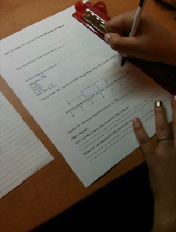
Drawing the Whiskers
Next to form what are known as the “whiskers”. This is the minimum value and maximum value that occur in the set of data. After making the markings for the last two values. We connect them to the box previously formed
Minimum value= 42
Maximum value= 69
These values are what create our whiskers

Slide 9
What is an Outlier?
We mentioned earlier that some values might be consider outliers. An outlier is a value that lies too far away or outside the range of what we would expect them to fall under.
To determine if a value is an outlier we first need to find the Interquartile Range.
The interquartile range (IQR) tells us how spread out the middle values are. It also tells us how the other values might be too far away.
IQR=Q3-Q1 our IQR= 60.5-49=11.5

Slide 10
Determining if Your Value is an Outlier
Using the IQR allows us to determining the length of our box and whisker plot.
An outlier is considered any value that lies more than 1.5 times the length of the box(IQR) from our box and whisker plot.
Q1-(1.5 x IQR) or Q3+(1.5 x IQR)
49-(1.5x11.5)=31.75 or 69+(1.5x11.5)=77.75
Do we have any outliers?

Slide 11
Our numbers would have to be
below 31.75 or above 77.75
Our data numbers are
42, 43, 46, 47, 48, 49, 49, 51, 52, 54, 55, 55, 56, 56, 57, 57, 57, 58, 60, 61, 62, 64, 64, 68, 69
So no, we do not have any outliers in this data

